Slide 1
Vector Norms
Vector norms are important in their own right and will lead to the development of matrix norms. Matrix norms are critical in determining bounds on errors that can occur during matrix computation.

Slide 2
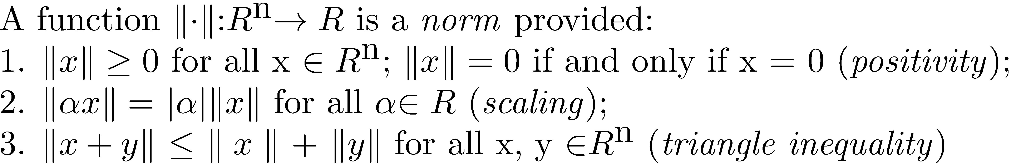
Definition of Vector Norm
A vector norm is a function that implements a method of measuring vector length and must satisfy the following properties.

Slide 3
The p-Norms
There are a variety of norms, but the most frequently used ones are the p-norms.

Slide 4
p-Norm Definition
The general definition of the p-norm is
The most frequently used p-norms are the1-, 2-, and infinity norm.
Euclidean norm

Slide 5
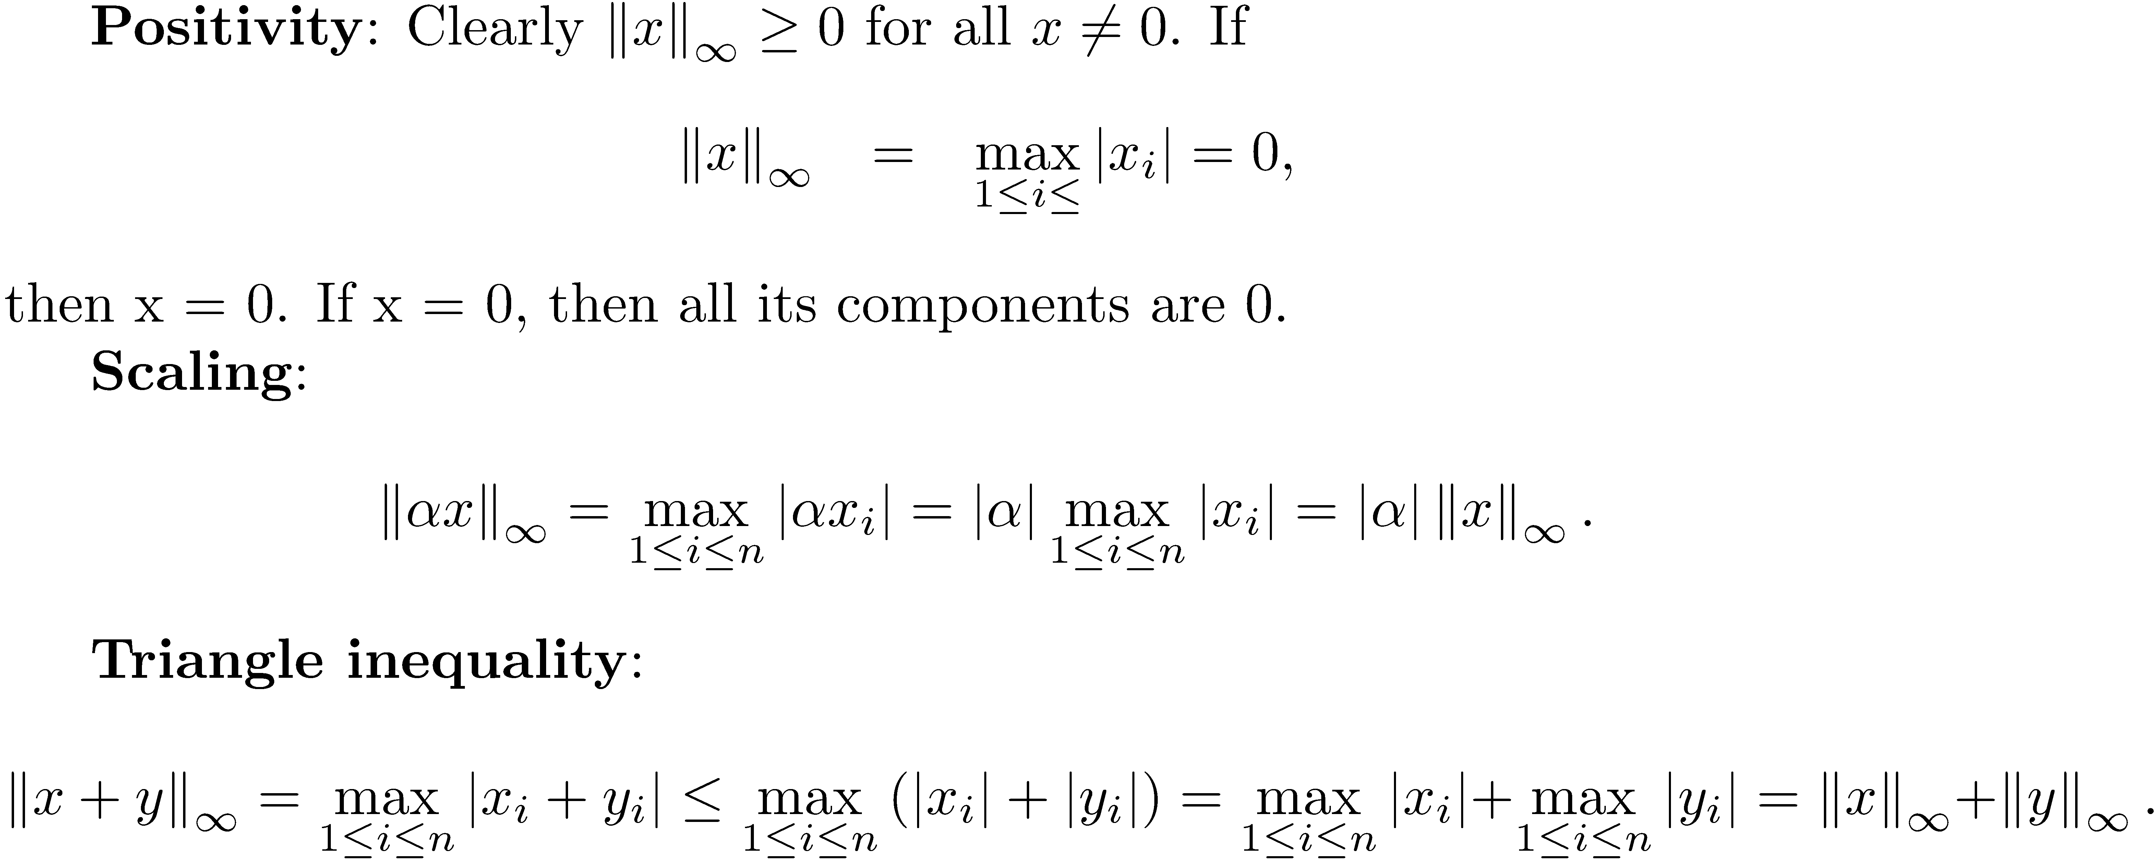
is a Norm

Slide 6
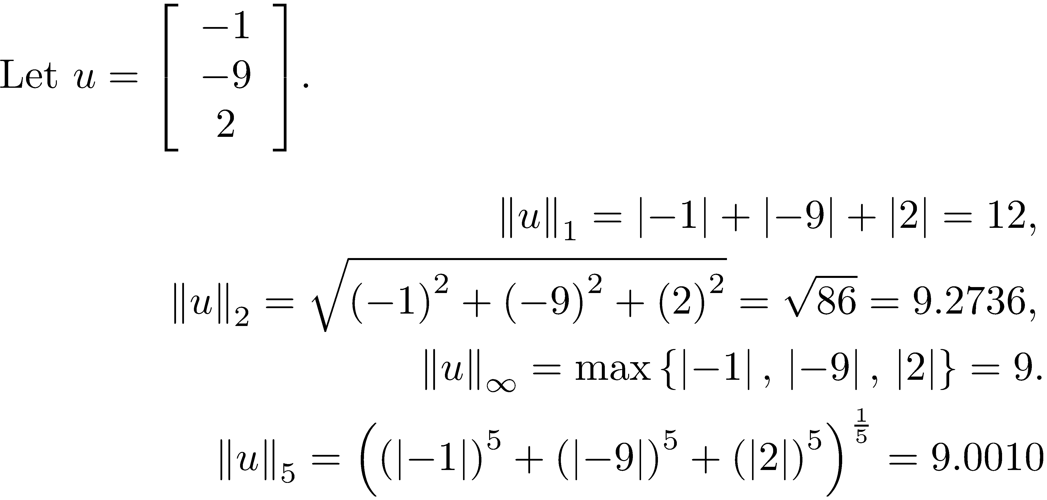
Example 1

Slide 7
Norm using MATLAB
MATLAB command:
norm(x,1)
norm(x,2)
norm(x,inf)

Slide 8
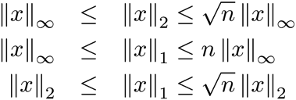
Relationship between Norms
Which norm to use may depend on the application. Also, all three norms are equivalent, which means that each norm is bounded below and above by a constant multiple of one of the other norms.

Slide 9
Properties of the 2-Norm
The 2-norm is the norm most frequently used in applications, and there are good reasons why this is true. There are many relationships satisfied by the 2-norm .

Slide 10
2-Norm - Important Inequalities
Cauchy-Schwarz inequality
Triangle inequality

Slide 11
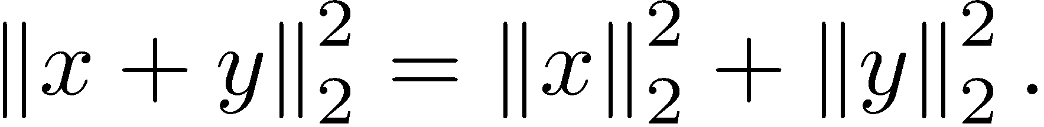
Pythagorean Theorem
If x and y are orthogonal,

Slide 12
Orthogonality and a Basis

Slide 13
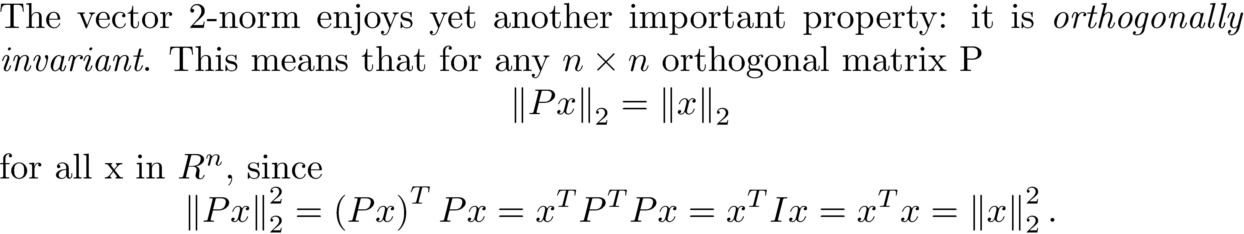
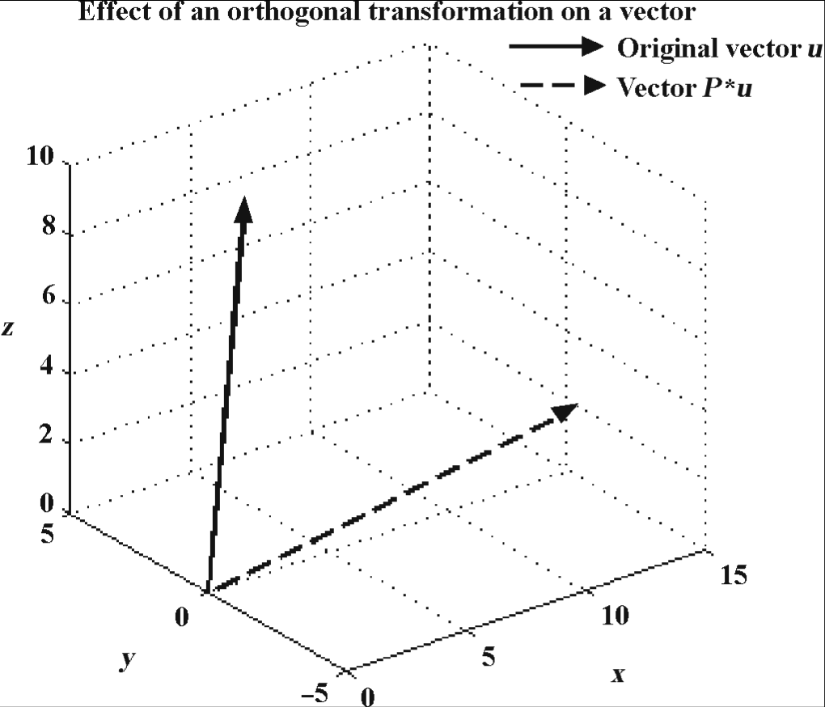
2-Norm Orthogonal Invariance
Result very important in computer graphics.
.

Slide 14
Change of Coordinates
Let u₁, u₂, …, u_{n} be an orthonormal basis for R^{n}. Form the orthogonal matrix U whose columns are u_{i}, 1 ≤ i ≤ n, and let x be a vector The vector is a representation of the vector x in the coordinate system whose axes are given by u₁, u₂, …, u_{n.} The lengths of vectors do not change in the new coordinate system.

Slide 15
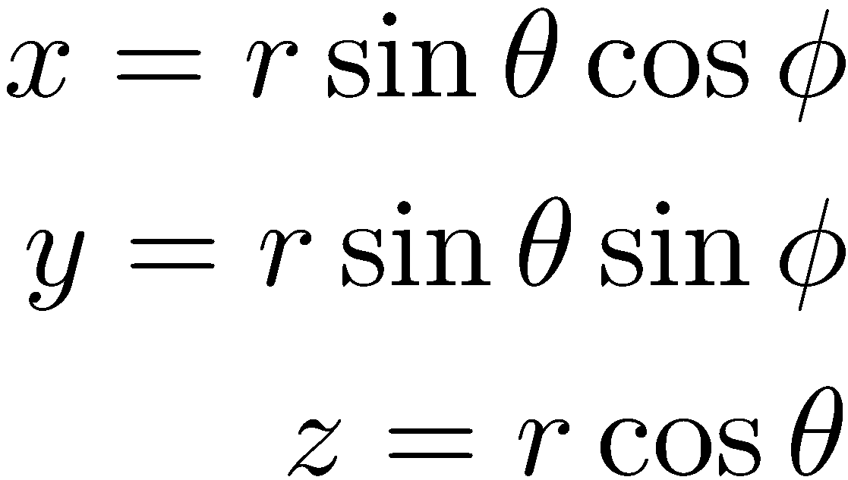
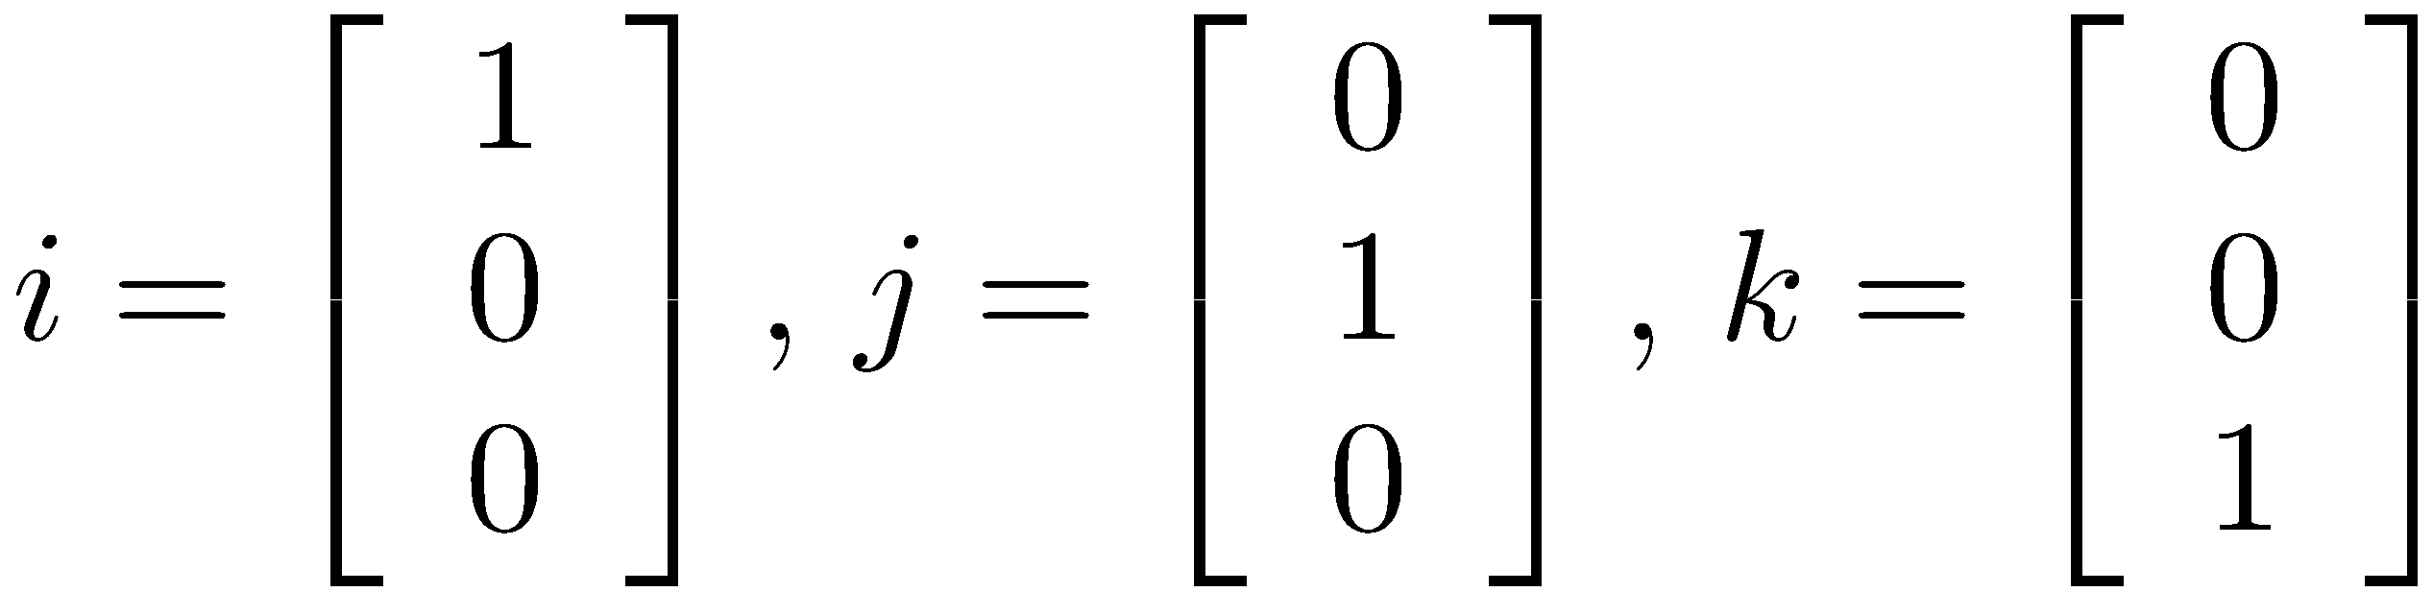
Spherical Coordinates
The representation for a point in space is given by three coordinates, .

Slide 16
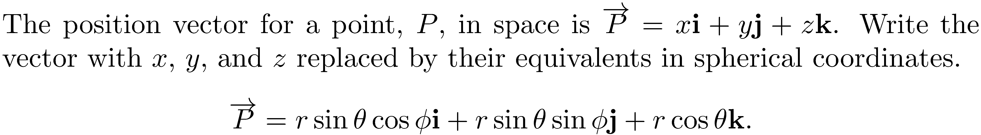
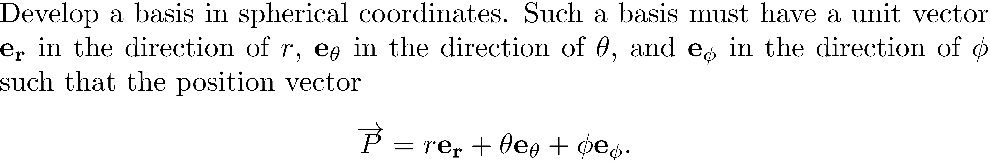
Basis in Spherical Coordinates

Slide 17
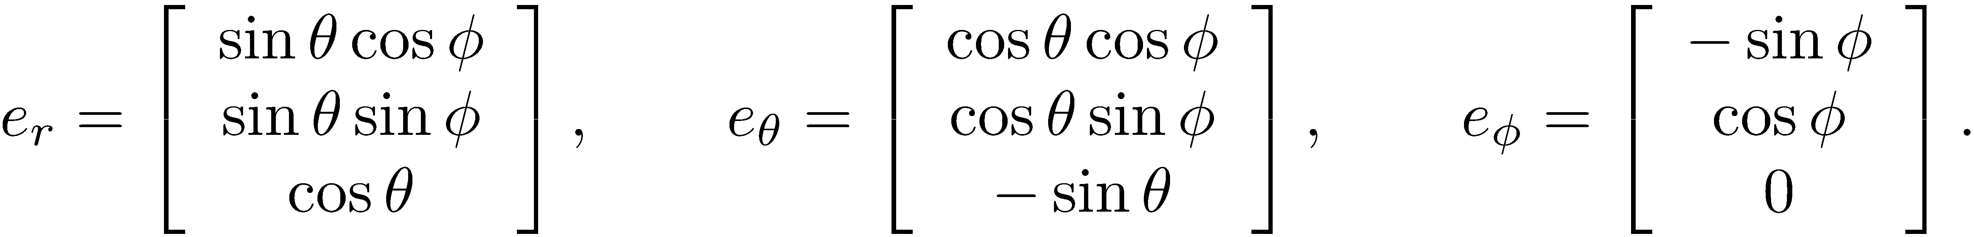
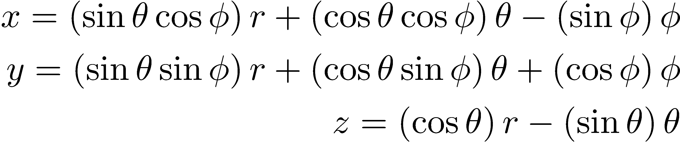
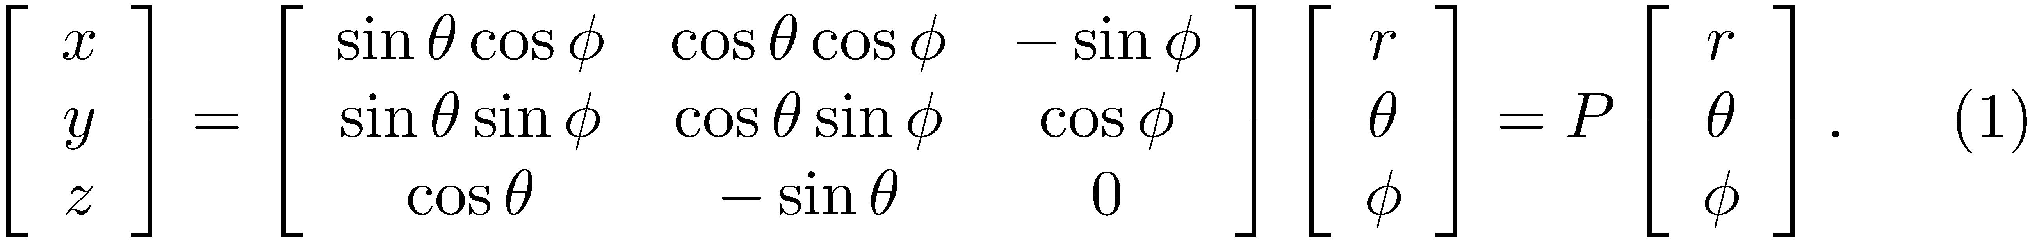
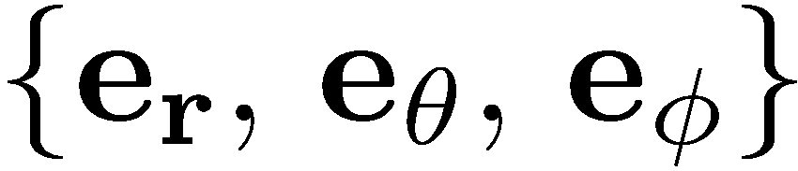
Basis in Spherical Coordinates (continued)
After some calculus
In matrix form
P is an orthogonal matrix.
is an orthonormal basis and is said to be local since the basis vectors change.

Slide 18
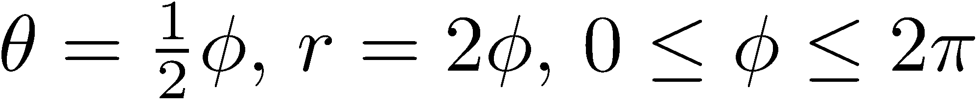
Basis in Spherical Coordinates (concluded)
Graph the surface determined by the equations .

Slide 19
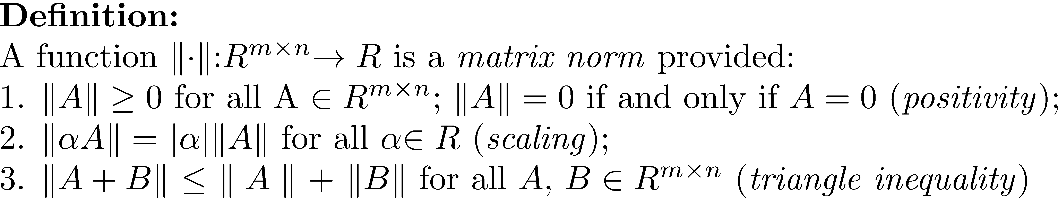
Matrix Norm
A real m × n matrix can be viewed as a vector in R^{mn} by concatenating rows or columns. As a result, the definition of a matrix norm is the same as that for a vector norm.

Slide 20
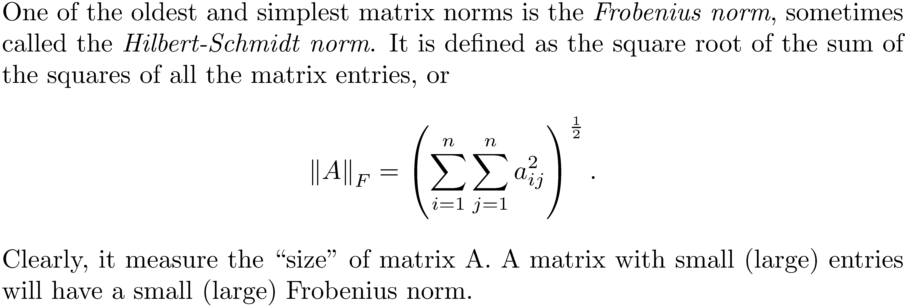
The Frobenius Matrix Norm

Slide 21
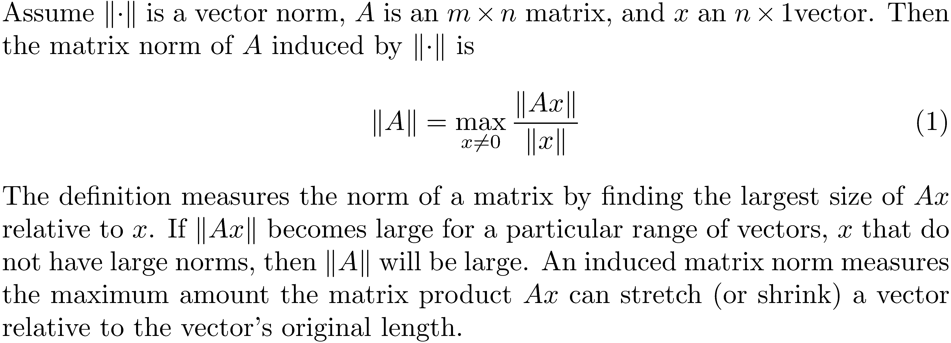
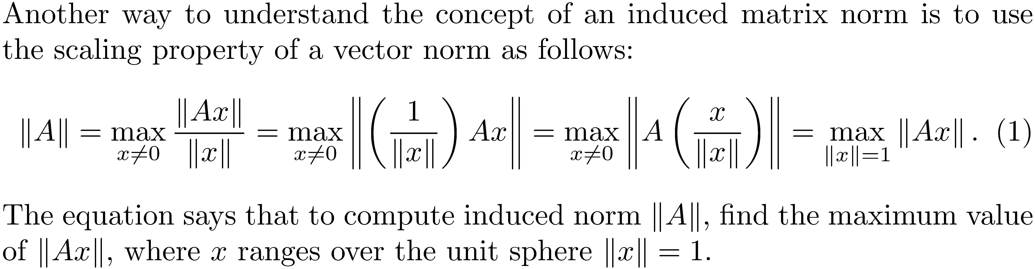
Induced Matrix Norms

Slide 22
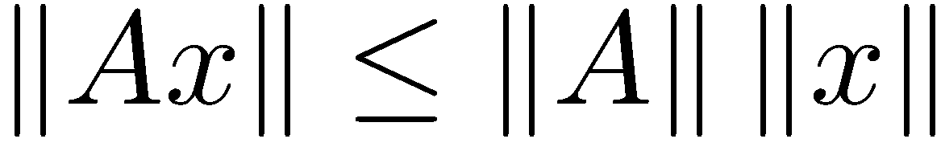
Extremely Important Result
The following result follows directly from the definition of an induced matrix norm.

Slide 23
Unit Spheres in the Plane

Slide 24
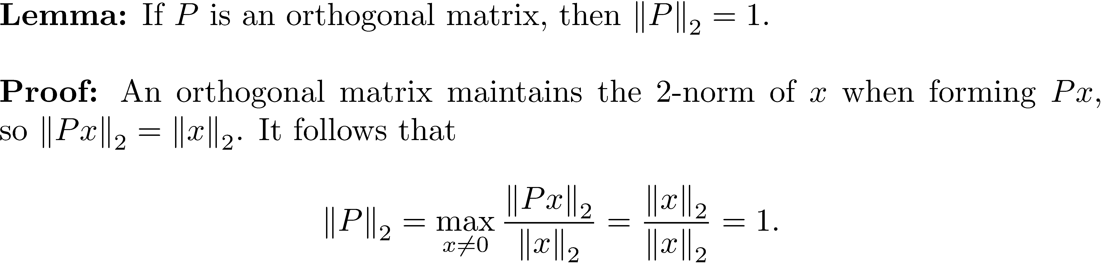
2-norm of an Orthogonal Matrix
Orthogonal matrices are beautiful things, and when it comes to their norms, they do not disappoint.

Slide 25
Experiment
The book provides a numerical experiment that uses random numbers to estimate the infinity norm of a 2 x 2 matrix and determines its value as the maximum absolute value row sum.
Let's do an experiment for a 3 × 3 matrix. In 3-dimensional space the infinity norm unit sphere is a square box with center at (0,0,0) and sides of length two.

Slide 26
Experiment
Top face:
z = 1, x, y vary
in range -1 ≤ x,y ≤ 1
Front face:
x = 1, y, z vary
in range -1 ≤ y,z ≤ 1

Slide 27
Experiment
MATLAB code to estimate .
function max = approxinfnorm_3D(A)
% approxinfnorm_3D Approximate the infinity norm of 3 x 3 matrix A.
%
% approxinf = approxinfnorm_3D(A) generates 1,000,002 random values
% on the infinity norm unit sphere in the 3D space and returns
% the maximum value of norm(Av,inf).
max = 0.0;
for i = 1:1000002
coord1 = 1 - 2*rand;
coord2 = 1 - 2*rand;
if i <= 166667
v = [1 coord1 coord2]';
elseif i <= 333334
v = [coord1 1 coord2]';
elseif i <= 500001
v = [coord1 coord2 1]';
elseif i <= 666668
v = [-1 coord1 coord2]';
elseif i <= 833335
v = [coord1 -1 coord2]';
else
v = [coord1 coord2 -1]';
end
bvalue = norm(A*v,'inf');
if bvalue > max
max = bvalue;
end
max = round(max);
end

Slide 28
Experiment
>> A = randi([-100 100],3,3)
A =
-13 -61 -44
57 -49 -32
-21 -97 -16
>> approxinfnorm_3D(A)
ans =
138
>> norm(A,inf)
ans =
138

Slide 29
Four Matrix Norms
The formula for calculating the Frobenius norm is straightforward. In the case the induced p-norms, we need a formula for , and this seems complicated. In fact, some significant mathematics is required, especially for the matrix 2-norm.

Slide 30
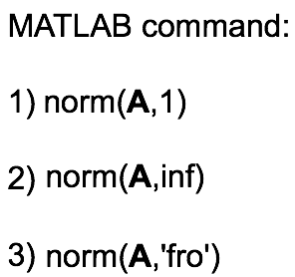
Norm Formulas
NOTE: A formula for the 2-norm is missing.
Its determination is more complex.

Slide 31
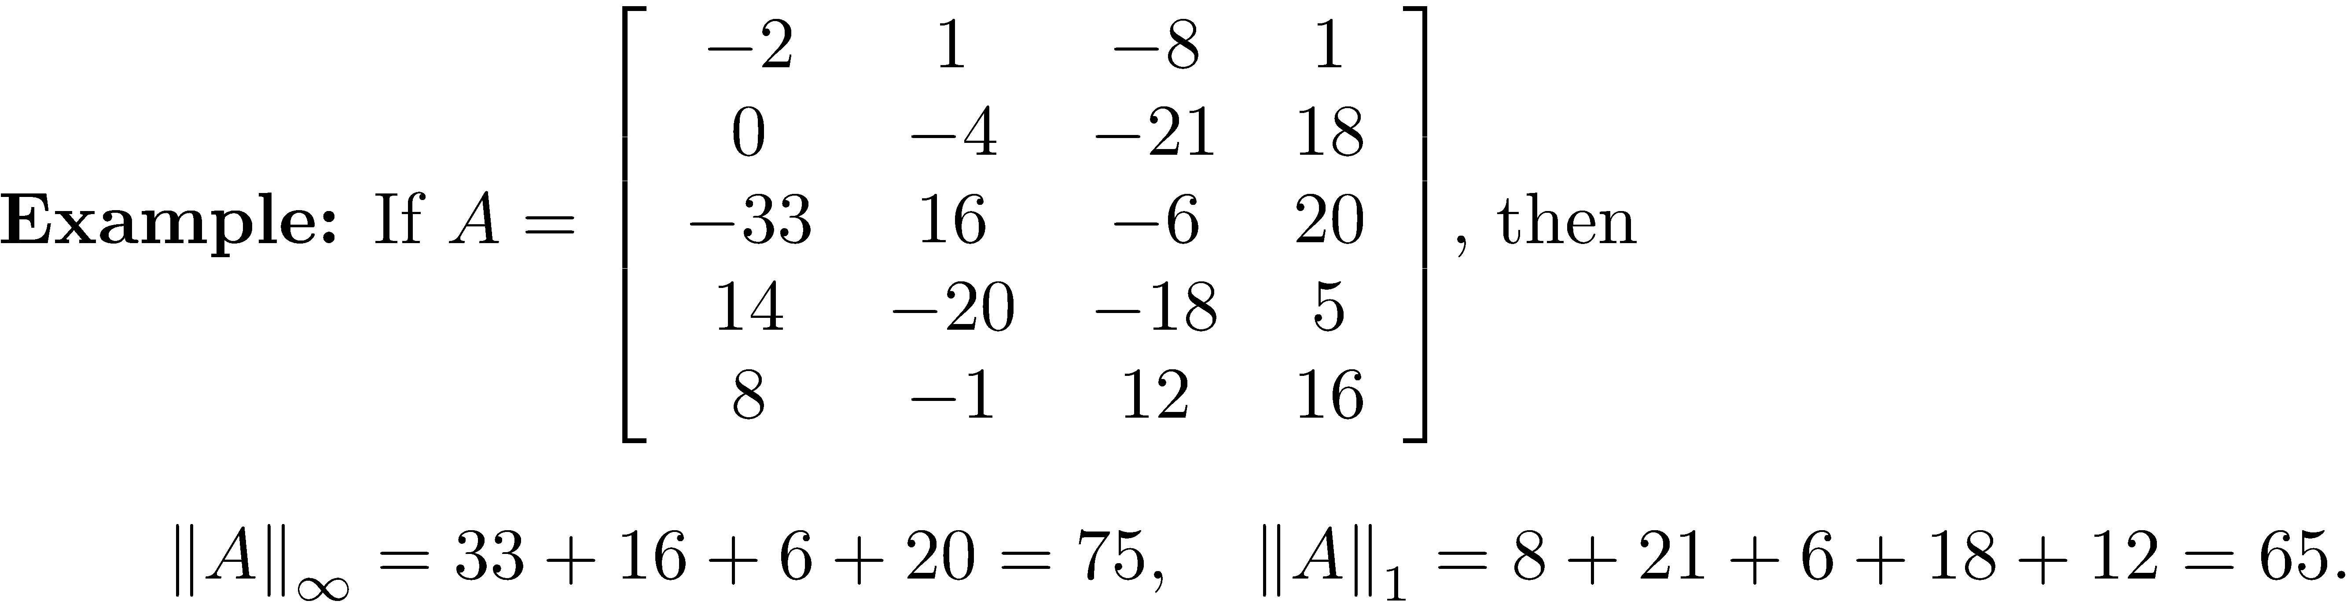
Example 2

Slide 32
Submultiplicative Matrix Norms
The Frobenius and the induced matrix norms are submultiplicative.

Slide 33
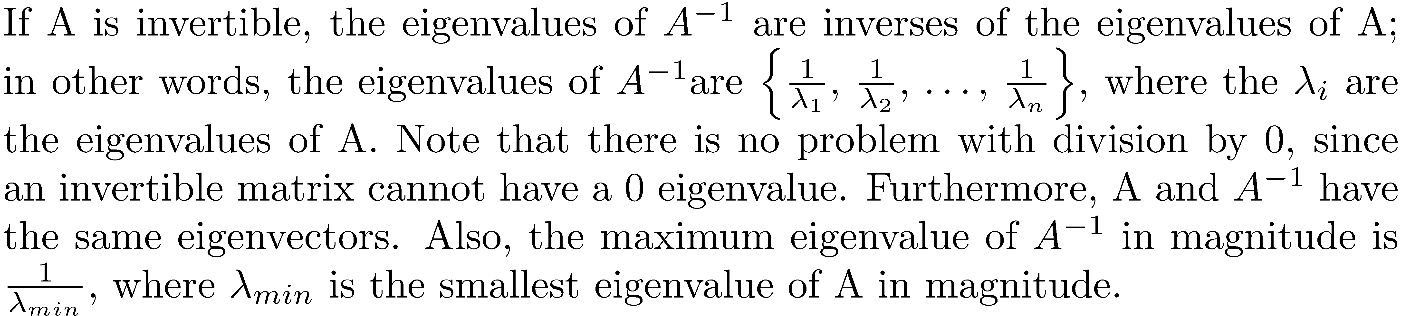
Important Result

Slide 34
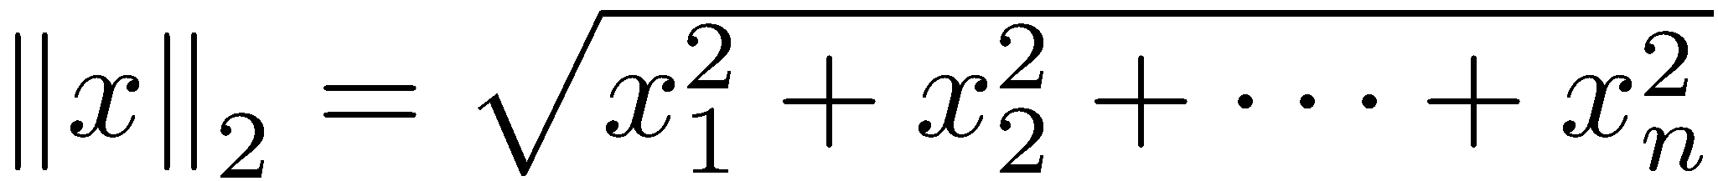
The Matrix 2-Norm
It would seem reasonable that this norm would be more complicated to calculate, since and this is true. However, is the most used matrix norm. The derivation of its value is involved; furthermore, its computation
In R^{n} , is the maximum value of for x on the unit circle. This is a nonlinear optimization problem with constraints.

Slide 35
Geometric Interpretation of the Matrix 2-Norm
It will be shown in Chapter 15 that the image of the unit sphere in R^{n} is an ellipse. The longest distance from the center of the ellipse to the ellipse boundary is the value of the 2-norm. In the plane, this is the length of the semimajor axis of the ellipse.

Slide 36
Computing
The eigenvalues of a symmetric matrix are real.
is symmetric, so it has real eigenvalues. Furthermore, it can be shown that the eigenvalues of are nonnegative ( ≥ 0 ).
The square roots of the eigenvalues of are termed singular values of A . The 2-norm of an m × n matrix, A , is the largest singular value.

Slide 37
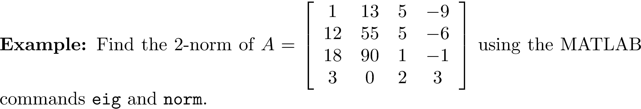
Example using MATLAB
>> E = eig(A'*A)
E = 1.0e+004 *
0.0000
0.0021
0.0131
1.1802
>> sqrt(max(E))
ans = 108.6373
>> norm(A,2)
ans = 108.6373
>> norm(A) % default without second argument is the 2-norm
ans = 108.6373

Slide 38
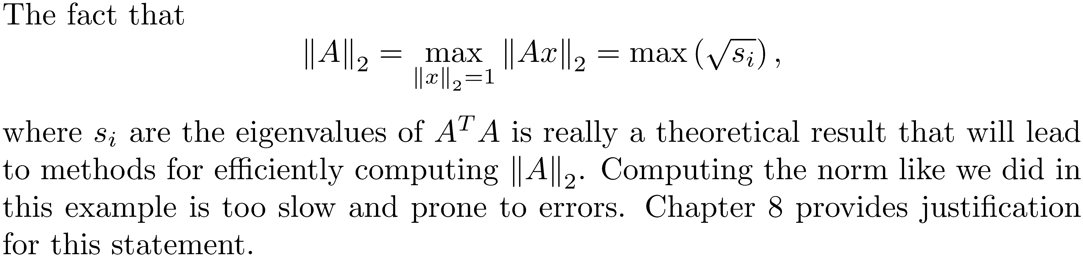
Example using MATLAB

Slide 39
Mathematical Derivation of the Formula for
We will do this by developing a series of facts.

Slide 40
Fact 1
The eigenvalues of a symmetric matrix are real, and the corresponding eigenvectors can always be assumed to be real.
>> A = rand(5,5);
>> A = A + A';
>> eig(A)
ans =
-0.9970
-0.7524
0.1524
0.7215
5.7668

Slide 41
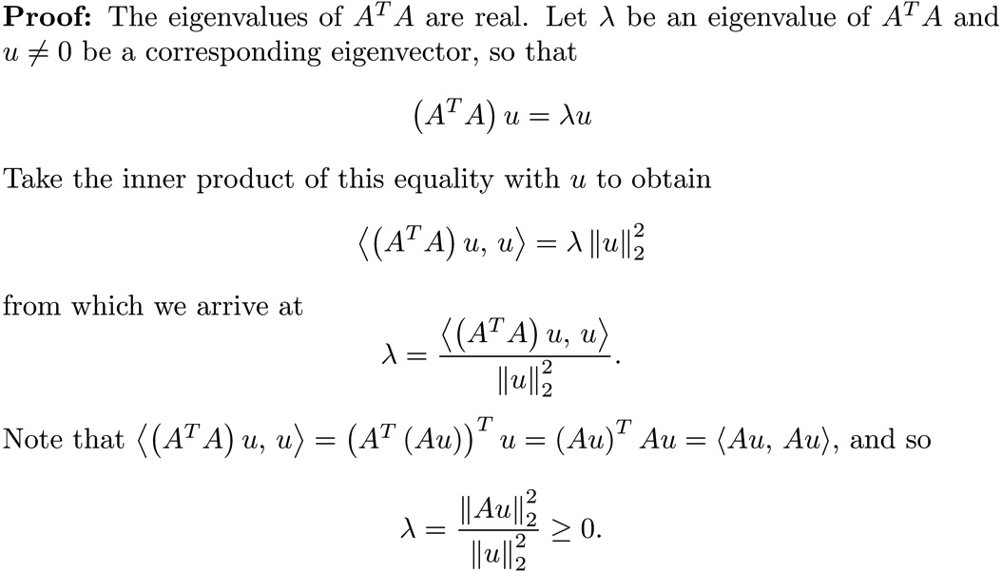
Fact 2
If A is an m × n real matrix, then the eigenvalues of the symmetric n × n matrix A^{T}A are nonnegative.

Slide 42
Why We Care about A^{T}A

Slide 43
Fact 3
If A is a real symmetric matrix, there exists an orthogonal matrix P such that D = P^{T}AP, where D is a diagonal matrix containing the real eigenvalues of A, and the columns of P are an orthonormal set of eigenvalues that form a basis for .

Slide 44
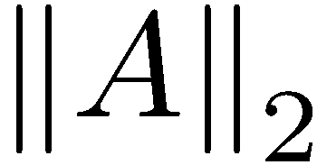
Computing the Matrix 2-Norm
These facts allow us to prove the following theorem, which specifies how to compute .

Slide 45
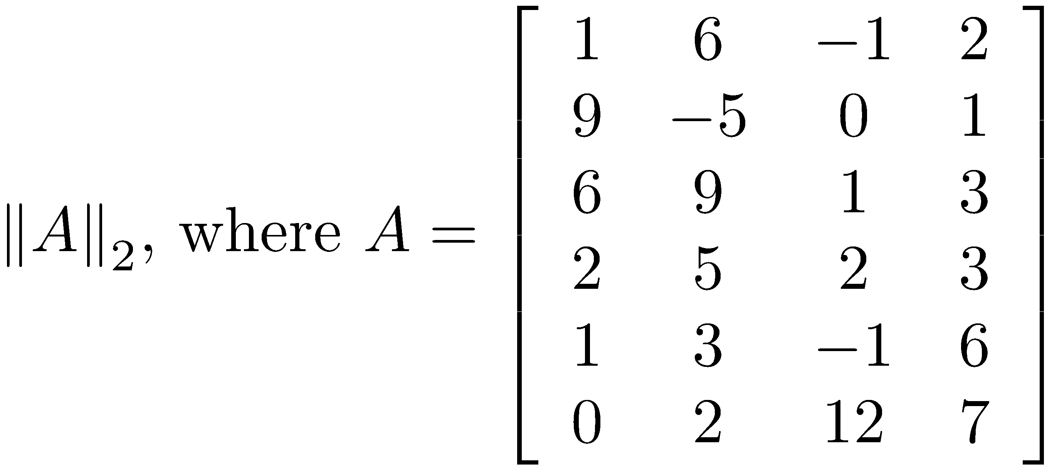
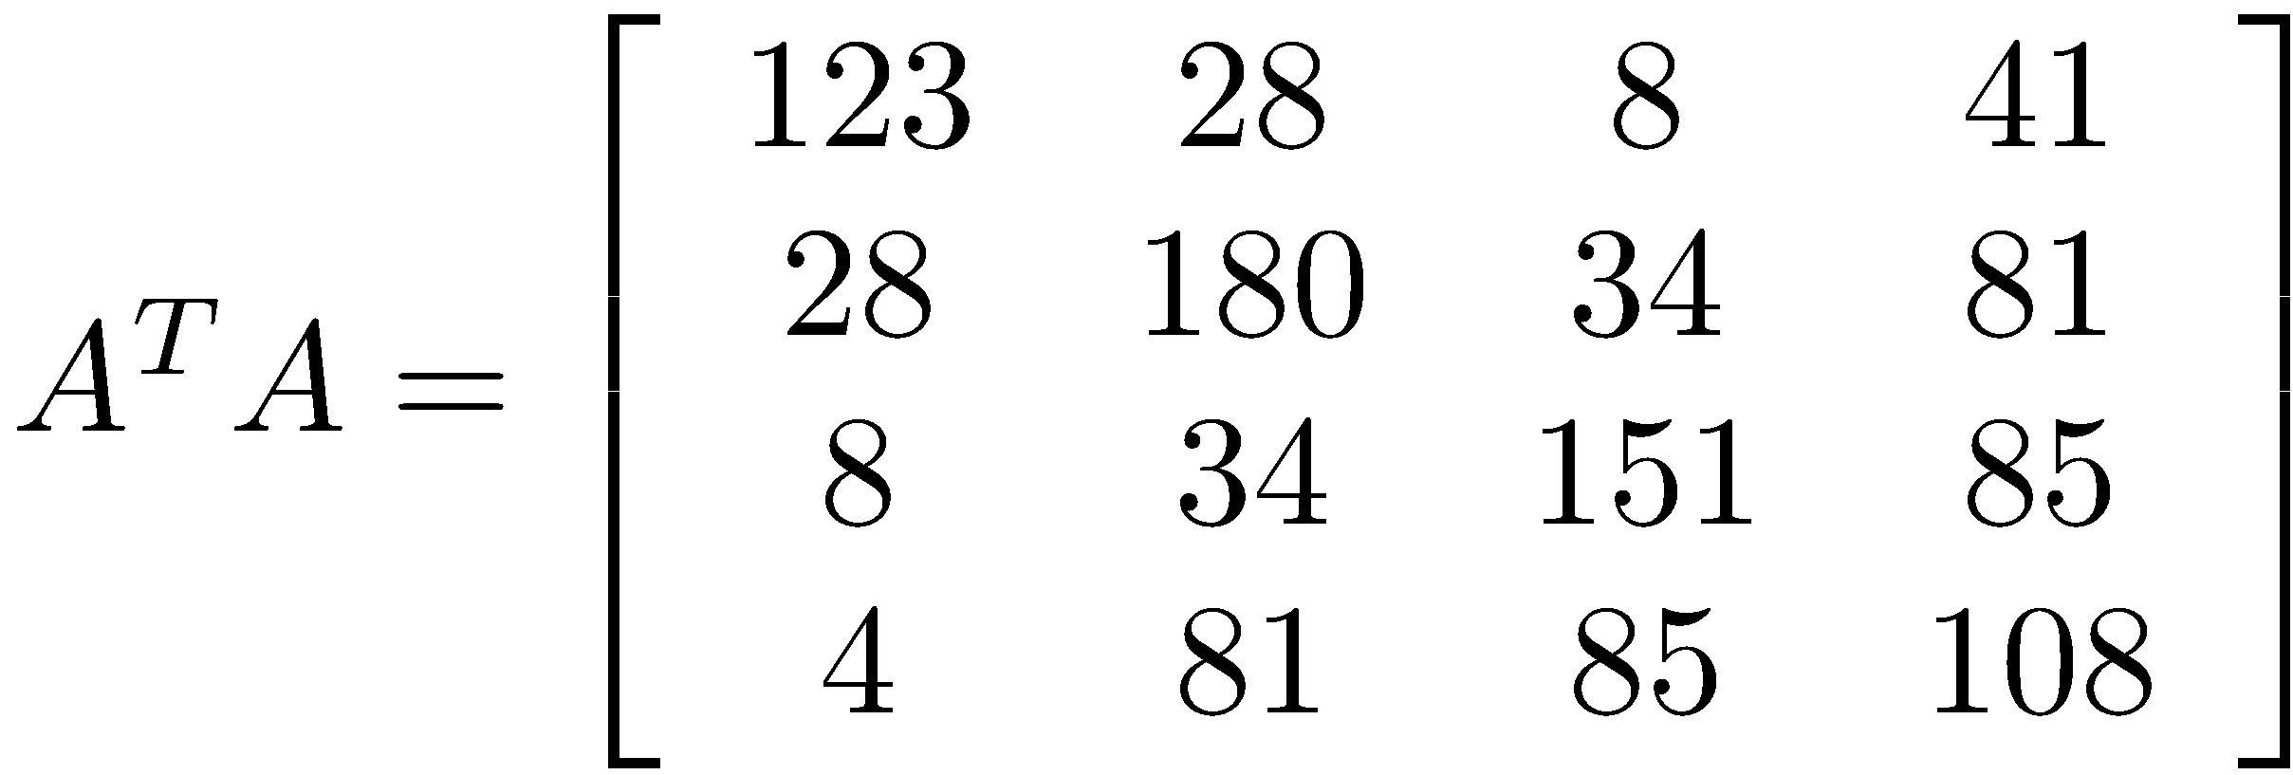
Example 3
Let
Using the MATLAB function eig,
the eigenvalues of A^{T}A (necessarily ≥ 0) are

Slide 46
Orthogonal Matrices and the 2-Norm
The matrix 2-norm inherits orthogonal invariance from the vector 2-norm. If U and V are orthogonal matrices,
>> U
U =
0.8000 0 -0.6000
0 1.0000 0
0.6000 0 0.8000
>> V
V =
1.0000 0 0
0 0.9923 -0.1240
0 0.1240 0.9923
>> A = randi([-10 10],3,3);
>> norm(U*A*V)
ans =
17.3478
>> norm(A)
ans =
17.3478
Orthogonal matrix
Orthogonal matrix

Slide 47
Orthogonal Matrices and the 2-Norm
The fact that orthogonal matrices do not change the value of norms will be very important later.

Slide 48
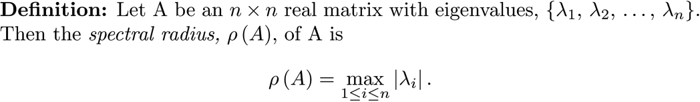
The Spectral Radius
>> A = randn(5,5);
>> E = eig(A)
E =
-2.5431 + 0.0000i
2.4648 + 0.0000i
-0.2734 + 0.8696i
-0.2734 - 0.8696i
-0.1729 + 0.0000i
>> max(abs(E)) % compute the spectral radius of A
ans =
2.5431

Slide 49
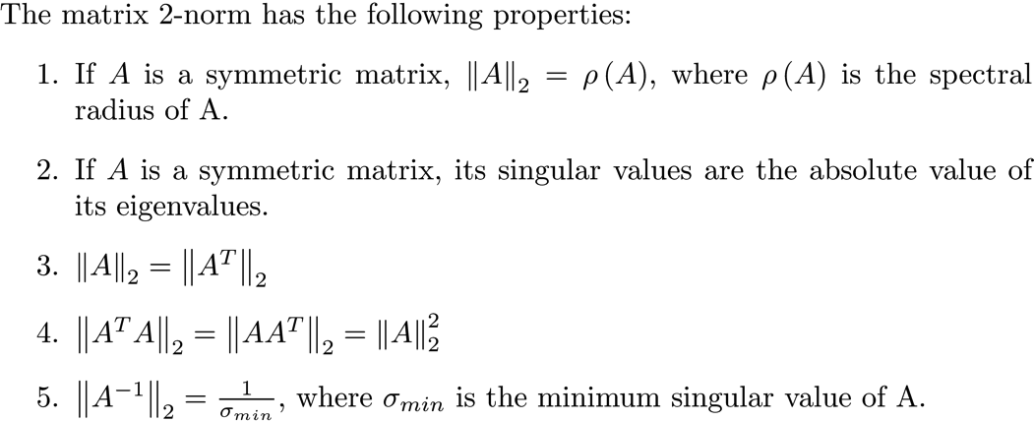
Properties of the Matrix 2-Norm

